Slide 1
MindCore Open Science Workshop
Feb 13th 2019
Julia A. Leonard

Slide 2
Today’s plan
Part 1: Analytic freedom and pre-registration
Part 2: Reproducible workflows

Slide 3
Today’s plan
Part 1: Analytic freedom and pre-registration
Part 2: Reproducible workflows

Slide 4
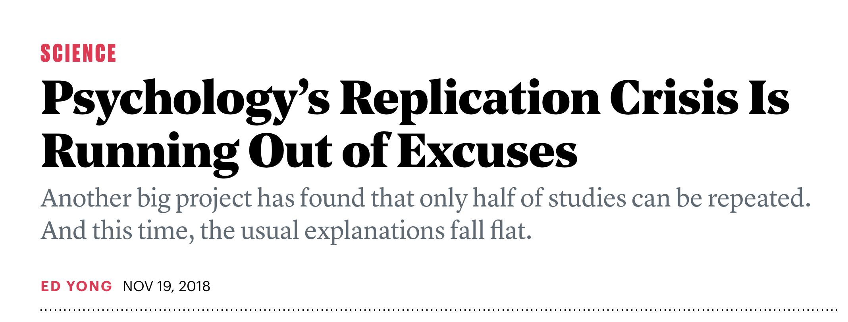
!!!!!
!!!!!
Notes:
I’m sure by now many of you have heard about the replication crisis. Where only 36% of the studies replicated in psychology experiments, with around half replicating in economics. This is making front page news in the world of psychological sciences today. So let’s examine a quick case.

Slide 5
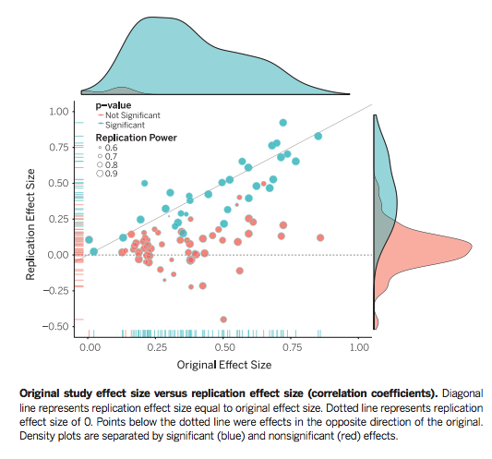
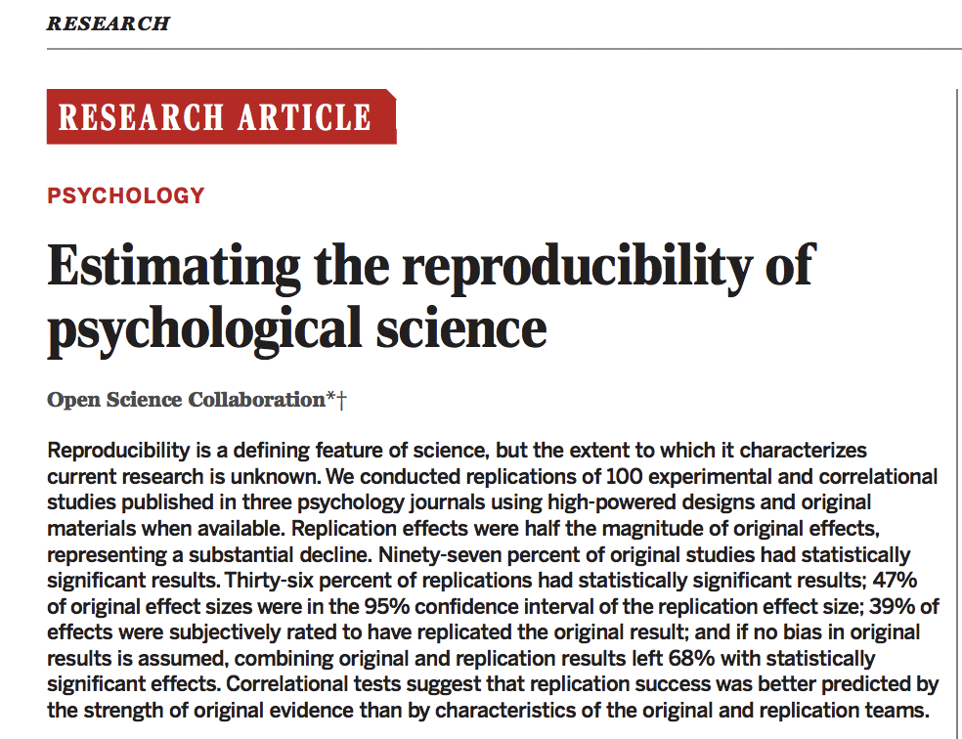
Notes:
A large group of scientists got together to create the “open science collaboration” where they set out to replicate 100 psychological studies.
First of all, What counts as a replication is a hard question – effect size? P value? So they used multiple ways of assessing replication including subjective report from the folks conducting the replication.
Out of the 100 studies– only 36% had “significant results – using p values”
47% of original effect sizes were in the 95% confidence interval of the replication effect size. And 39% were subjectively rated to have replicated. This was pretty dim and made a lot of headlines

Slide 6
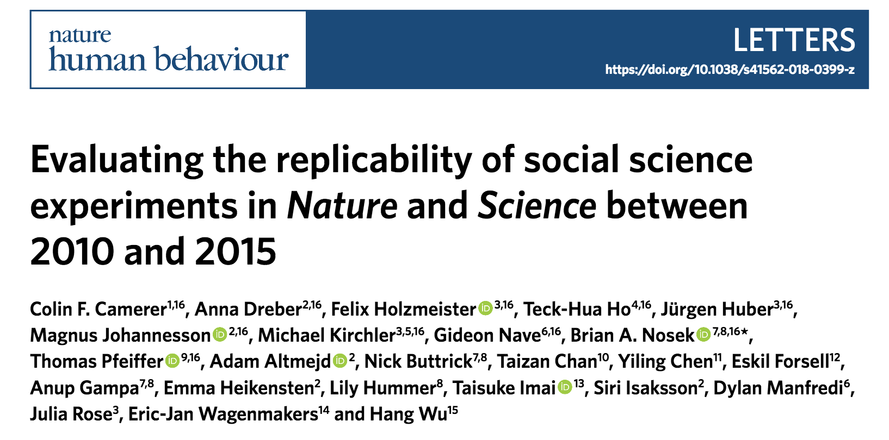
Skeptics
Replication attempts themselves were too small (need higher Ns)
Researchers involved might have not been competent
People vary – could get different results across different populations
Many labs 2
Replicated 21 studies in Nature and Science
Total N = 15,305 → 60 times as many volunteers as the studies they were attempting to replicate!
Researchers vetted experiments beforehand
Repeated experiments across 36 countries
13/21 studies replicated!
Notes:
However, as I mentioned, what counts as a replication is hard.
So a team of economists and psychologists got together to run this project again (the previous one was many labs 1 and now this is many labs 2). This time they attempted
The Many Labs 2 project was specifically designed to address these criticisms (nature and science replication of 21 studies). With 15,305 participants in total, the new experiments had, on average, 60 times as many volunteers as the studies they were attempting to replicate. The researchers involved worked with the scientists behind the original studies to vet and check every detail of the experiments beforehand. And they repeated those experiments many times over, with volunteers from 36 different countries, to see if the studies would replicate in some cultures and contexts but not others. “It’s been the biggest bear of a project,” says Brian Nosek from the Center for Open Science, who helped to coordinate it. “It’s 28 papers’ worth of stuff in one.”
Despite the large sample sizes and the blessings of the original teams, the team failed to replicate half of the studies it focused on (13/21 replicated). It couldn’t, for example, show that people subconsciously exposed to the concept of heat were more likely to believe in global warming, or that moral transgressions create a need for physical cleanliness in the style of Lady Macbeth, or that people who grow up with more siblings are more altruistic. And as in previous big projects, online bettors were surprisingly good at predicting beforehand which studies would ultimately replicate. Somehow, they could intuit which studies were reliable

Slide 7
From Camerer et al., 2018
Notes:
“prediction market”—a stock exchange in which volunteers could buy or sell “shares” in the 21 studies, based on how reproducible they seemed. They recruited 206 volunteers—a mix of psychologists and economists, students and professors, none of whom were involved in the SSRP itself. Each started with $100 and could earn more by correctly betting on studies that eventually panned out.
Look at the graph and compare the blue diamonds to the yellow diamonds.
The market assigned higher odds of success for the 13 studies that were successfully replicated than the eight that weren’t—compare the blue diamonds to the yellow diamonds.
Kind of nice that we have some intuition already of which study will replicate
What clues did people look for? Small sample size, p value,
Beyond statistical issues, it strikes me that several of the studies that didn’t replicate have another quality in common: newsworthiness. They reported cute, attention-grabbing, whoa-if-true results that conform to the biases of at least some parts of society. One purportedly showed that reading literary fiction improves our ability to understand other people’s beliefs and desires. Another said that thinking analytically weakens belief in religion. Yet another said that people who think about computers are worse at recalling old information—a phenomenon that the authors billed as “the Google effect.” All of these were widely covered in the media.

Slide 8
Why are we having a ‘replication crisis’?

Slide 9
Some candidates
Incentive structure: we get reward for positive, cool result
Fallibility of memory (what did you actually set out to do?)
Cognitive biases (consciously occurring or not)
Notes:
One pressure for “positive” results
Novel results are rewarded more than redundant or incremental additions to existing knowledge. Positive results––finding a relationship between variables or an effect of treatments on outcomes––are rewarded more than negative results––failing to find a relationship or effect; clean results that provide a strong narrative are rewarded more than outcomes that show uncertainty or exceptions to the favored narrative.
However, we have to acknowledge that achieving a novel, positive, clean result is a rare event.
Researchers may design a study to investigate one question and, upon observing the outcomes, misremember the original purposes as more aligned with what was observed. Researchers may genuinely believe that they would have predicted, or even that they did predict, the outcomes as observed
Researchers may employ confirmation bias by seeking evidence consistent with their expectations and finding fault or ignoring evidence that is inconsistent with their expectations
This post-hoc theorizing is a form of circular reasoning–– generating a hypothesis based on observing data, and then evaluating the validity of the hypothesis based on the same data.
Moreover, good intentions are not sufficient to overcome these three factors.

Slide 10
Analytic Freedom
Stopping criterion: how many participants/neurons is enough?
Exclusion criterion: what is a ‘bad’ participant/neuron?
Analysis choices: which covariates? raw or normalized?
Family of comparisons: which is the ‘key’ DV?
Is this really a problem?
“A vast number of choices for analyzing data ... could be made. If those choices are made during analysis, observing the data may make some paths more likely and others less likely. By the end, it may be impossible to estimate the paths that could have been selected if the data had looked different...” Nosek et al., 2018
From Rebecca Saxe course 2018
Notes:
But what we do have some control over is our analyses right?– yet as scientists we have A LOT of analytic freedom. When we design and analyze studies we make A LOT of decisions. Here are just a few and these are hard decisions to make.
Pause talk about what makes a “bad” participant.
Does anyone else have experiences they want to share?
This leaves the observed P values with unknown diagnosticity, rendering them uninterpretable. In other words, null hypothesis significance testing cannot be used with confidence for postdiction. How do you even correct for multiple comparisons here? The number of tests done?

Slide 11
General Solution
Exploratory work first
Form prediction: specify the analysis / model completely
Pre-registration: Write it down Share publicly
Test prediction (fit, or statistic) in new data
From Rebecca Saxe course 2018

Slide 12
My own example

Slide 13
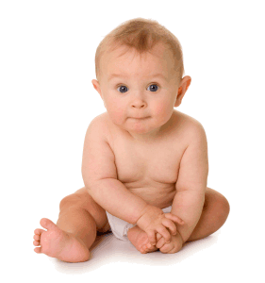
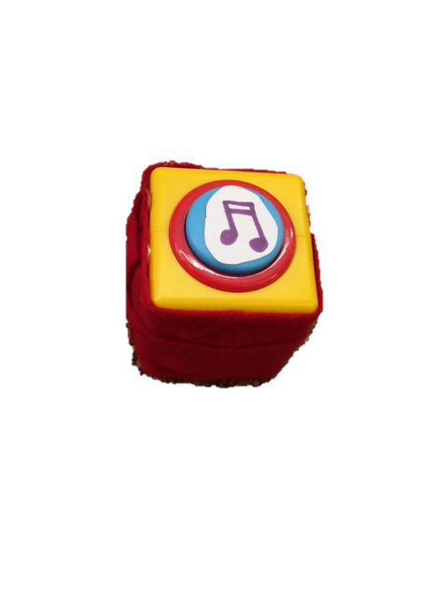
How do babies know how hard to persist on a novel task?
Can babies learn about effort by watching adults struggle?
Notes:
My research focuses on effort and persistence. In this study I was interested in exploring how babies know how hard to try on novel tasks.
In particular, I wanted to know whether babies could learn how hard to try by watching how hard adults try at different tasks.
We showed babies adults either trying hard or not trying hard on two tasks and wanted to see if babies would abstract from that information how hard they should try on a third novel task.

Slide 14
Experiment
N= 34/ condition 13-18 month olds
*p<.05, **p<.01
All analyses are
non-parametric
Notes:
I first ran this experiment with 34 kids per condition – no effort, baseline, and effort.
What you’re going to see on the y axis is number of button presses over all and then before first handoff
And what you see is that kids in the effort condition pushed the button more times overall than children in both the no effort condition and baseline.
We were really excited about this! But…

Slide 15
Analytic choices I made in first study
Stopping criterion: how many participants did I need? I ran a power analysis and had a number in mind, but this changed due to…
Exclusion criterion: what is a ‘bad’ participant. I wanted to exclude any baby where the parent talked to the child – it turned out that was around 40% of the sample. So my advisor asked me to include those participants back in which changed my N.
Analysis choices: many ways to code effort – I did pick a priori button presses. Also found out that data was non-normal and needed to transform it/ perform non-parametric analyses
Notes:
We made A LOT of choices along the way to doing this study.

Slide 16
Pre-registered replication
Notes:
https://osf.io/j4935/register/564d31db8c5e4a7c9694b2c2
So I ran a pre-registered replication of the contrast of interest – let me show you it here.

Slide 17

Experiment
N= 34/ condition 13-18 month olds
*p<.05, **p<.01
All analyses are
non-parametric
Replication
N= 40/ condition 13-18 month olds
Notes:
So I ran the experiment again with 40 babies per condition and replicated my result! Yay!
Now one striking thing is that even though my sample was bigger, you can clearly see that the effect was smaller. In fact, this effect was just significant. Meaning that the first time I got the result, I kinda got lucky by getting a big effect. In reality I think this effect is much subtler, but consistant.

Slide 18
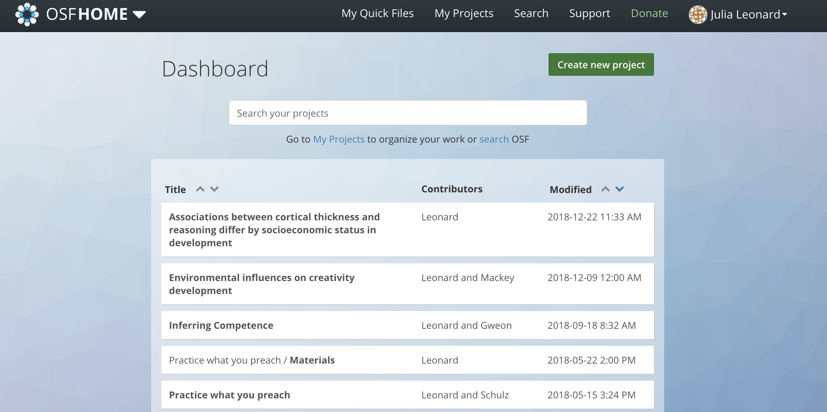
Pre-registration
Notes:
Pre-registration is free and easy to do – You can pre-register and share your projects on the open science frame work.
Has anyone done this? Thoughts?

Slide 19
Pre-registration: What to include?
For psychology, check the template van ‘t Veer, A.E., & Giner-Sorolla, R. (2016).
Describe the (numbered) hypotheses in terms of directional relationships between your (manipulated or measured) variables.
For interaction effects, describe the expected shape of the interactions.
If you are manipulating a variable, make predictions for successful check variables or explain why no manipulation check is included.
[...]
Describe the analyses that will test each main prediction from the hypotheses section. For each one, include:
the relevant variables and how they are calculated;
the statistical technique;
each variable’s role in the technique (e.g., IV, DV, moderator, mediator, covariate); rationale for each covariate used, if any...
From Rebecca Saxe course 2018

Slide 20
Pre-registration
Frequently updated step by step instructions on how to use the OSF for pre-registration: https://osf.io/k5wns/
Video on how to use registrations on the OSF: http://help.osf.io/ m/registrations/l/524205-registrations-101
Pre-registration badge specifications: https://osf.io/tvyxz/wiki/ 1.%20View%20the%20Badges/
From Rebecca Saxe course 2018

Slide 21
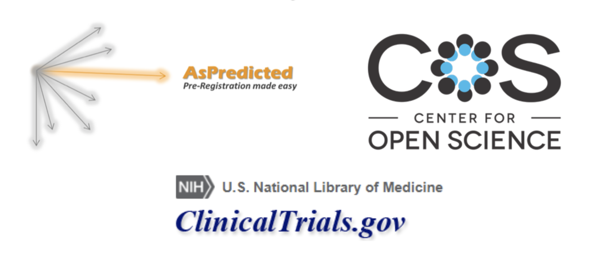
Pre-registration
From Rebecca Saxe course 2018
Notes:
Here are a few places where I know you can pre-register.

Slide 22
What Pre-Reg doesn’t fix
Deliberate dishonesty
Pre-registering studies after completing them
Bad pre-registration (e.g. multiple comparisons, double-dipping)
Unclear pre-registrations
Ignoring the pre-registration (Franco: 70% of papers drop an outcome!)
Confounded experiments
Boring experiments
Results that don’t generalize (e.g. limits on generalization)
As of now, little up-take in (cognitive) neuroscience →no template
From Rebecca Saxe course 2018
Notes:
But before we all go out and pre-register, know it doesn’t fix everything.
Imagine, for example, that you get a positive result once every 20 tries. Even though every experiment is preregistered, given the aggregate program of research, it is plausible that the positive results are occurring by chance.

Slide 23
My personal experience
Definitely fell prey to analytic flexibility in the past
I have found pre-registrations more challenging for fmri than behavioral studies → much longer documents with more analytic decisions to be made
Switched over to mostly pre-reg studies in 2016 → since then have published results explicitly labeled “exploratory” when not pre-registered
I find it helpful to write pre-registrations because it clarifies exactly what I am hoping to find and test. Gets my research team on board. I don’t think it effects if work is done, but rather slows down when it gets done.
I still prefer independent replication, but sometimes that is not feasible (esp. difficult large sample fmri studies with kids!)

Slide 24
Your experiences?

Slide 25
Today’s plan
Part 1: Analytic freedom and pre-registration
Part 2: Reproducible workflows

Slide 26
The Standard ir-reproducible workflow
1. Complex, ever-changing customizable scripts
2. Figures copied into presentations and papers. Statistical values copied into word processing software
These are hopelessly confusing to future self or future grad students working on the project. Also doesn’t incentivize re-generating the script and thus learning more/ catching errors!
These are error prone!
From Rebecca Saxe course 2018

Slide 27
Question for you
An experience of irreproducible analysis in your own life

Slide 28
Reproducible Analysis part 1
Proactively code for full, portable replicability
Reified file structure (e.g., BIDS for fmri data)
Store this pipeline in an “open” way that saves edits along the way → e.g., github or OSF or even dropbox
1. Complex, ever-changing customizable scripts
From Rebecca Saxe course 2018

Slide 29
Reproducible Analysis part 1
Focus on documentation from the start
Raw data -> Process commands
Analysis data -> Analysis commands
Generated results
Data Appendix and Read Me files!
Checkpoint, packrat (R), anaconda- projects (python), Docker
1. Complex, ever-changing customizable scripts
From Rebecca Saxe course 2018

Slide 30
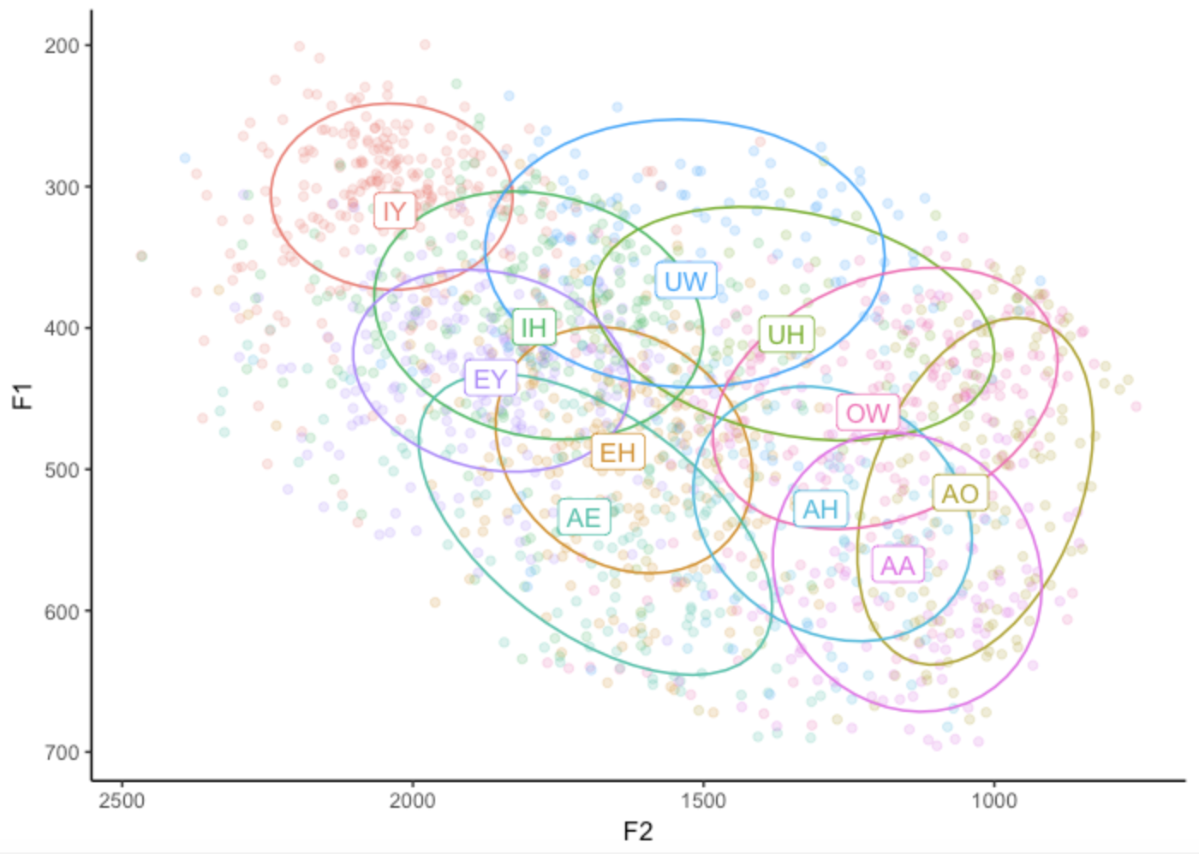
Reproducible Analysis part 2
Dynamic document generation: integrate analysis (coding) and presentation (writing) e.g. RMarkdown, knitr/Sweave, and Automate formatting (papaja)
Once you’re good at it, very pretty plots
2. Figures copied into presentations and papers. Statistical values copied into word processing software
http://joeystanley.com/blog/making-vowel-plots-in-r-part-1

Slide 31
Reproducible Analysis part 3
Code is submitted with the paper for review / replication / etc
e.g. github links in papers, OSF projects, etc
e.g. providing RMarkdown HTML
Examples:
https://kemacdonald.com/
https://langcog.github.io/PAQ/
Notes:
https://kemacdonald.com/
https://langcog.github.io/PAQ/

Slide 32
Reproducible analysis: Theory
Portable, version controlled code in reified directories
Dynamic document generation for record-keeping, collaboration, open sharing, and publication
Publicly shared {data and} complete code
From Rebecca Saxe course 2018

Slide 33
Reproducible analysis: Reality
No short term incentive, some upfront cost (e.g. R)
Friction with existing lab / PI culture
codebase is a shared resource, often not pristine
collaborators on manuscripts use Word ☺
Analysis that depends on other languages / platforms (very common in neuroimaging, comp cog sci, etc)
Intuitively easier for confirmatory than exploratory phase
Secrecy? Competitive advantage?
From Rebecca Saxe course 2018

Slide 34
Question for you
A time you tried to create a more reproducible analysis but hit a significant roadblock
Useful advice to newbies for relatively small initial steps with big impacts, before swallowing the program whole
What are your favorite ways to do open science?
How have you managed working with advisors who may not be familiar with the “newest” software?

Slide 35
Open Science Workshops/ Resources
For neuroscience:
BrainHacks →https://www.brainhack.org/
Neurohackacademy → https://neurohackweek.github.io/
OpenNeuro → https://openneuro.org/
For psychology:
Data on the mind workshop →http://www.dataonthemind.org/
For both:
https://osf.io
Github
R studio

